Slide 1
Discussion 8 - Scheme
Chris Allsman

Slide 2
Agenda
Administrivia/Intro Stuff
Why do we care about Scheme?
Overview of Scheme Features & Syntax
Linked Lists & Scheme Codewriting

Slide 3
Discussion
What’s the most frustrating issue you’ve run into with Scheme so far?
What about Scheme still doesn’t make sense?
What’s one cool/interesting thing about Scheme?

Slide 4
Administrivia
Maps Composition out, due Sunday
HW7 due today
Guerrilla Section Saturday 12-2
MT2 grades out, regrades due Friday

Slide 5
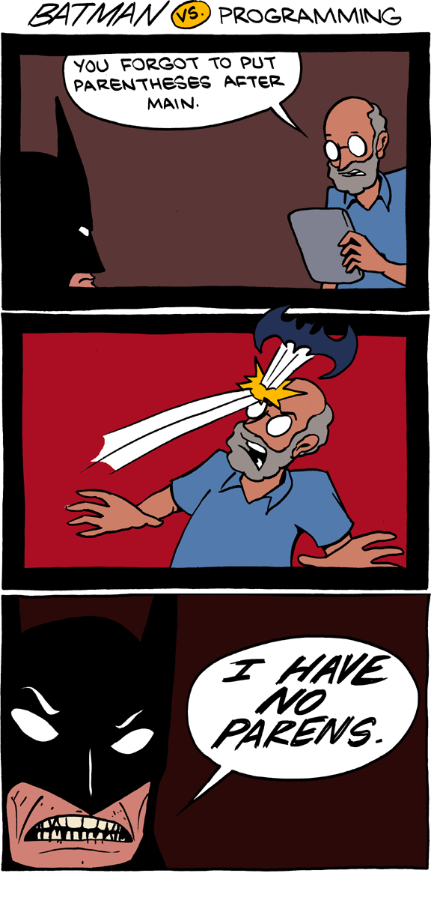
Why Scheme?

Slide 6
Simple!
All expressions kinda look the same, not too difficult to understand
It’s possible for you to understand the workings of the Scheme interpreter
Can focus on concepts you’ve already learned
How do you pick up a new language?
How are languages implemented?

Slide 7
Functional!
Modifying state is messy….
What if we make everything stateless?
Functional programming: all computation done by applying/evaluating functions
Deterministic! Clean!
Only data types - atoms and lists!
Oh, and if you care about this, functional programming is relevant for parts of “industry”
Notes:
Note: we do see mutation in Scheme, but not nearly to the same level as it occurs in Python.

Slide 8
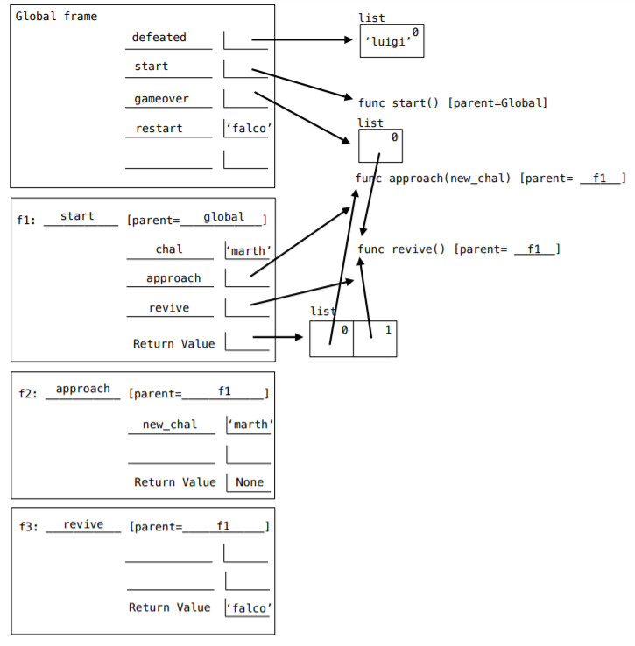
Functional!
Modifying state is messy….
What if we make everything stateless?
Functional programming: all computation done by applying/evaluating functions
Deterministic! Clean!
Only data types - primitives and lists!
Oh, and if you care about this, “industry” is moving towards functional programming
Notes:
We don’t have to worry about this!

Slide 9
Interesting!
When I said everything is a list or atom….
I mean EVERYTHING
Also cool stuff like macros
Code that writes other code!

Slide 10


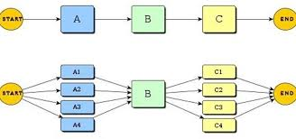
Bottom Line:
As a 61A Student:
As a Computer Scientist:

Slide 11

Scheme Lists
A linked list formed by chaining together pairs
Creating a pair: cons
Takes in exactly 2 arguments, returns a pair
Second argument is a list or nil
Getting first element: car
Getting second element: cdr

Slide 12
How do you construct these Scheme lists?
#1
2
3
#2
1
2
3

Slide 13
How do you construct these Scheme lists?
#1
2
3
>>> (cons 2 (cons 3 nil)
(2 3)
#2
1
2
3

Slide 14
How do you construct these Scheme lists?
#1
2
3
>>> (cons 2 (cons 3 nil)
(2 3)
>>> (cons 1 (cons
(cons 2 (cons 3 nil))
nil)
(1 (2 3))
#2
1
2
3

Slide 15
Rule for displaying Pairs
1
2
(1 2)
Lists without nesting (the car of each pair is not a list) just have each element displayed inside a set of parentheses separated by a space

Slide 16
Rule for displaying Pairs
1
2
3
4
Lists with nesting still have each element separated by a space. Nested lists are in their own set of parentheses, and the rules follow recursively.

Slide 17
Rule for displaying Pairs
(1 ... )
1
2
3
4
Lists with nesting still have each element separated by a space. Nested lists are in their own set of parentheses, and the rules follow recursively.

Slide 18
Rule for displaying Pairs
(1 (2 … 3) )
1
2
3
4
Lists with nesting still have each element separated by a space. Nested lists are in their own set of parentheses, and the rules follow recursively.

Slide 19
Rule for displaying Pairs
(1 (2 (4) 3) )
1
2
3
4
Lists with nesting still have each element separated by a space. Nested lists are in their own set of parentheses, and the rules follow recursively.

Slide 20
Constructing lists
(cons <first-expr> <list-expr>):
takes in exactly 2 arguments
use recursively to make well-formed list:
first argument: first element in list
second argument: rest of list
(list <first-expr> <second-expr> ...):
takes in any amount of arguments
intuitively make well-formed lists by listing all the elements
‘(<first-elem> <second-elem> ...):
takes in exactly 1 argument
returns a list that looks exactly like the argument
nothing within the parentheses is evaluated
(cons 6 (cons 1 (cons ‘a nil)))
(list 6 1 ‘a)
(quote (6 1 a))
‘(6 1 a)

Slide 21
When to use?
cons:
When you want to add an element on to the start of a list
Ex: add an element to the start of the list returned by a recursive call
list:
When you have multiple elements you want to put into a list
Passing in a list will create nesting
Ex: want to create a two element list containing x and y
quote:
When you know the exact structure of the list and the values you want to put in
Will not evaluate expressions
Ex: create a list to pass in as an argument in an interactive session

Slide 22
Summary: 3 views of lists
How do we construct the list?
cons, list, quote
What is the structure of the list?
Box-and-pointer diagrams
Tells you what car/cdr return
How is the list displayed?
e.g. nested parentheses = nested list

Slide 23
Summary: 3 views of lists
How do we construct the list?
cons, list, quote
What is the structure of the list?
Box-and-pointer diagrams
Tells you what car/cdr return
How is the list displayed?
e.g. nested parentheses = nested list
Cons gives you first & rest element of each pair in the box & pointer

Slide 24
Summary: 3 views of lists
How do we construct the list?
cons, list, quote
What is the structure of the list?
Box-and-pointer diagrams
Tells you what car/cdr return
How is the list displayed?
e.g. nested parentheses = nested list
Follow rules from previous slide

Slide 25
Summary: 3 views of lists
How do we construct the list?
cons, list, quote
What is the structure of the list?
Box-and-pointer diagrams
Tells you what car/cdr return
How is the list displayed?
e.g. nested parentheses = nested list
Quote the representation to get a constructor!

Slide 26

Attendance
links.cs61a.org/chris-disc

Slide 27
Reminder: Codewriting with Scheme Lists
Python | Scheme
Link(first, rest) | (cons first rest)
lst.first | (car lst)
lst.rest | (cdr lst)
Link.empty | nil

